Slide 1
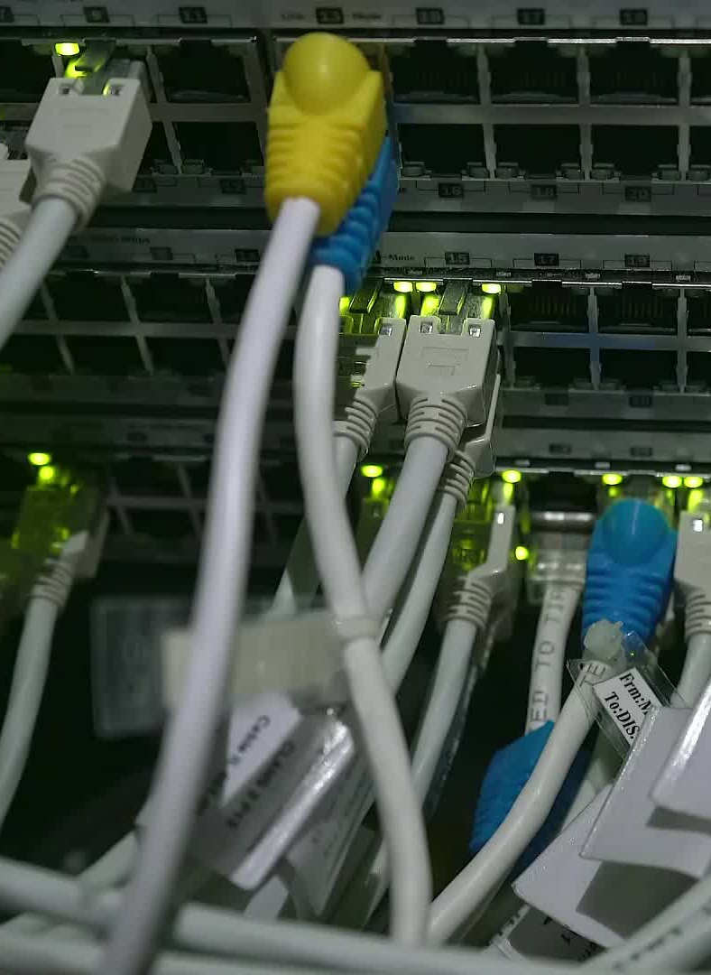
Network Standards
By
Dr Sanjeev Kumar Mandal

Slide 2
Network Standards
Standards are the set of rules for data communication that are needed for exchange of information among devices.
Standards help in creating and maintaining open markets and allow different vendors to compete on the basis of the quality of their products while being compatible with existing market products.
During data communication, a number of standards may be used simultaneously at the different layers. The commonly used standards at each layer are −

Slide 3
Layers with Standards:
Application layer | TTP, HTML, POP, H.323, IMAP
Transport layer | TCP, SPX
Network layer | IP, IPX
Data link layer | Ethernet IEEE 802.3, X.25, Frame Relay
Physical layer | RS-232C (cable), V.92 (modem)

Slide 4

Types of Standards
Standards are of two types :
De Facto Standard.
De Jure Standard.

Slide 5

De Facto Standard :
The meaning of the work ” De Facto ” is ” By Fact ” or “By Convention”. These are the standards that have not been approved by any Organization , but have been adopted as Standards because of it’s widespread use. Also , sometimes these standards are often established by Manufacturers.
For example : Apple and Google are two companies which established their own rules on their products which are different . Also they use some same standard rules for manufacturing for their products.

Slide 6
De Jure Standard
Meaning of the word “De Jure” is “By Law” or “By Regulations”
Thus , these are the standards that have been approved by officially recognized body like ANSI , ISO , IEEE etc.
These are the standard which are important to follow if it is required or needed.
For example : All the data communication standard protocols like SMTP , TCP , IP , UDP etc. are important to follow the same when we needed them.

Slide 7
Standards organizations
Some of the noted standards organizations are
International Standards Organization (ISO)
International Telecommunication Union (ITU)
Institute of Electronics and Electrical Engineers (IEEE)
American National Standards Institute (ANSI)
Internet Research Task Force (IETF)
Electronic Industries Association (EIA)

Slide 8
Internet Standards: (Home Task)
What are internet Standards?
Organizations of Internet Standards.

Slide 9

Network Devices
Network hardware are physical devices that are used for communication between hardware on a computer network, those devices are:
Hub
Bridge
Switch
Router
Modem
Gateway
Repeater

Slide 10
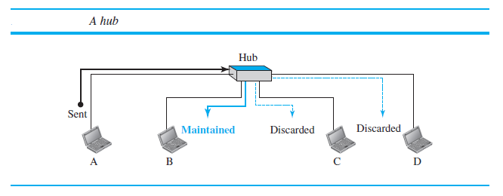
Hub
A hub is a device that operates only in the physical layer.
Signals that carry information within a network can travel a fixed distance before attenuation endangers the integrity of the data.

Slide 11
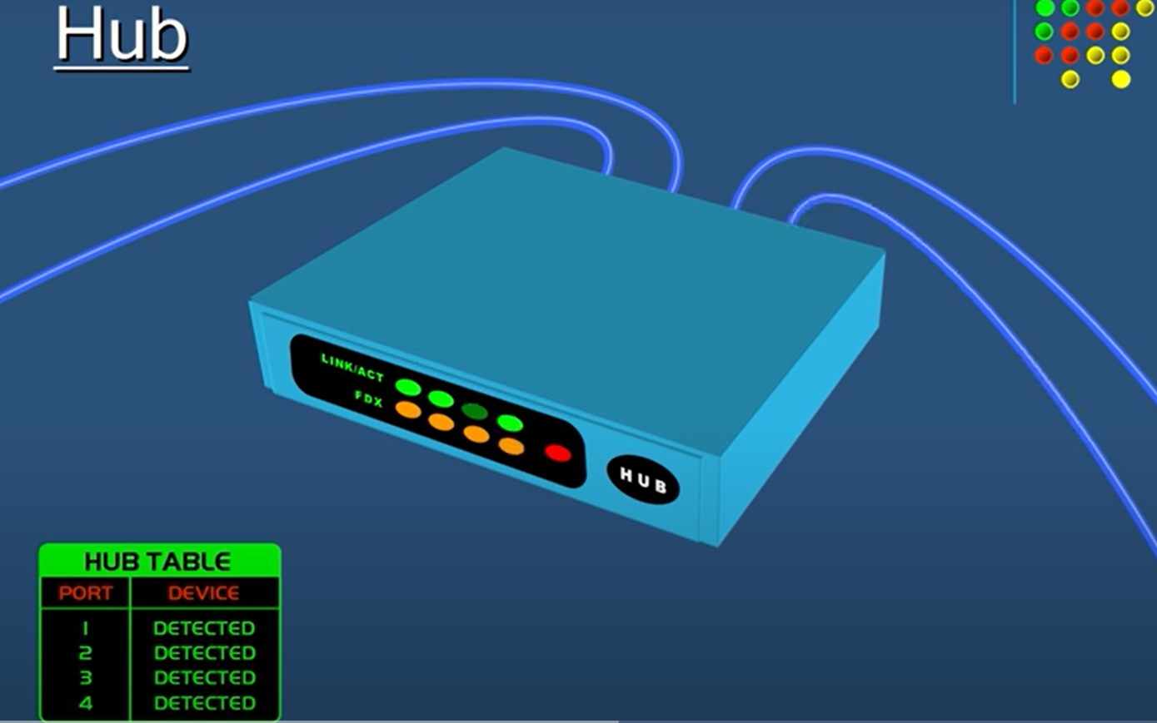
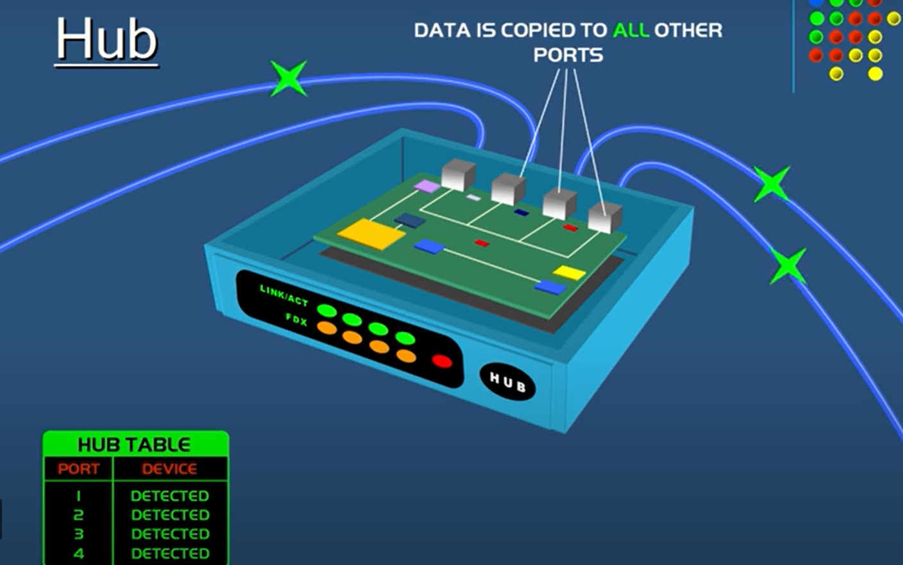
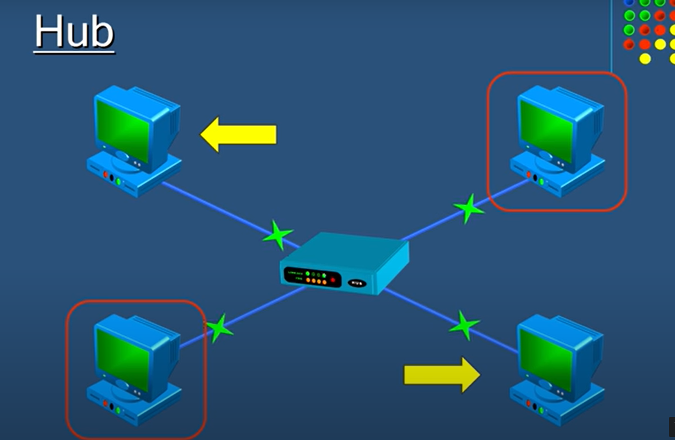
Hub

Slide 12
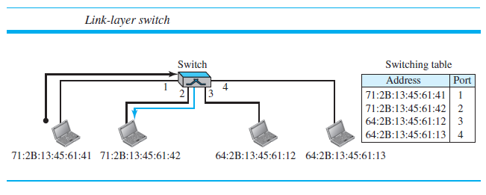
Switch
A switch is a data link layer device.
The switch can perform error checking before forwarding data which makes it very efficient as it does not forward packets that have errors and forward good packets selectively to the correct port only.

Slide 13
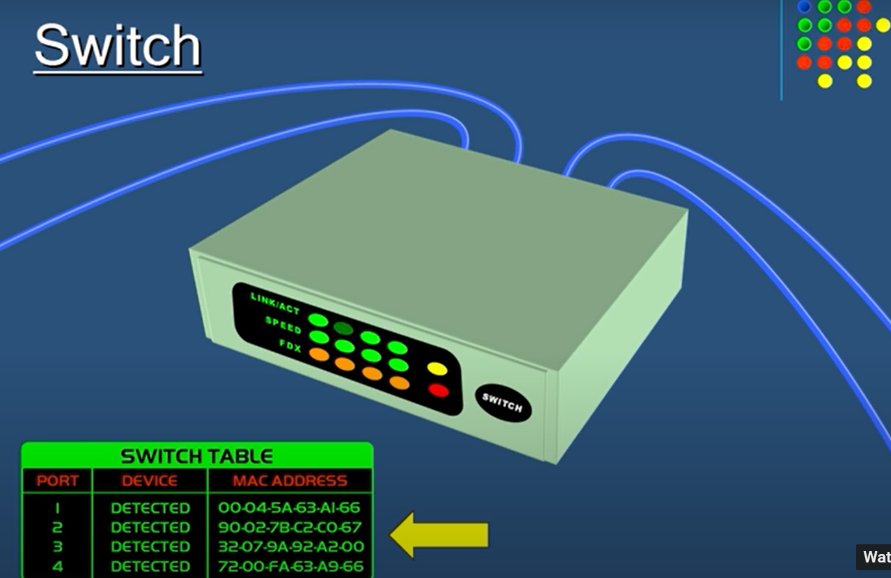
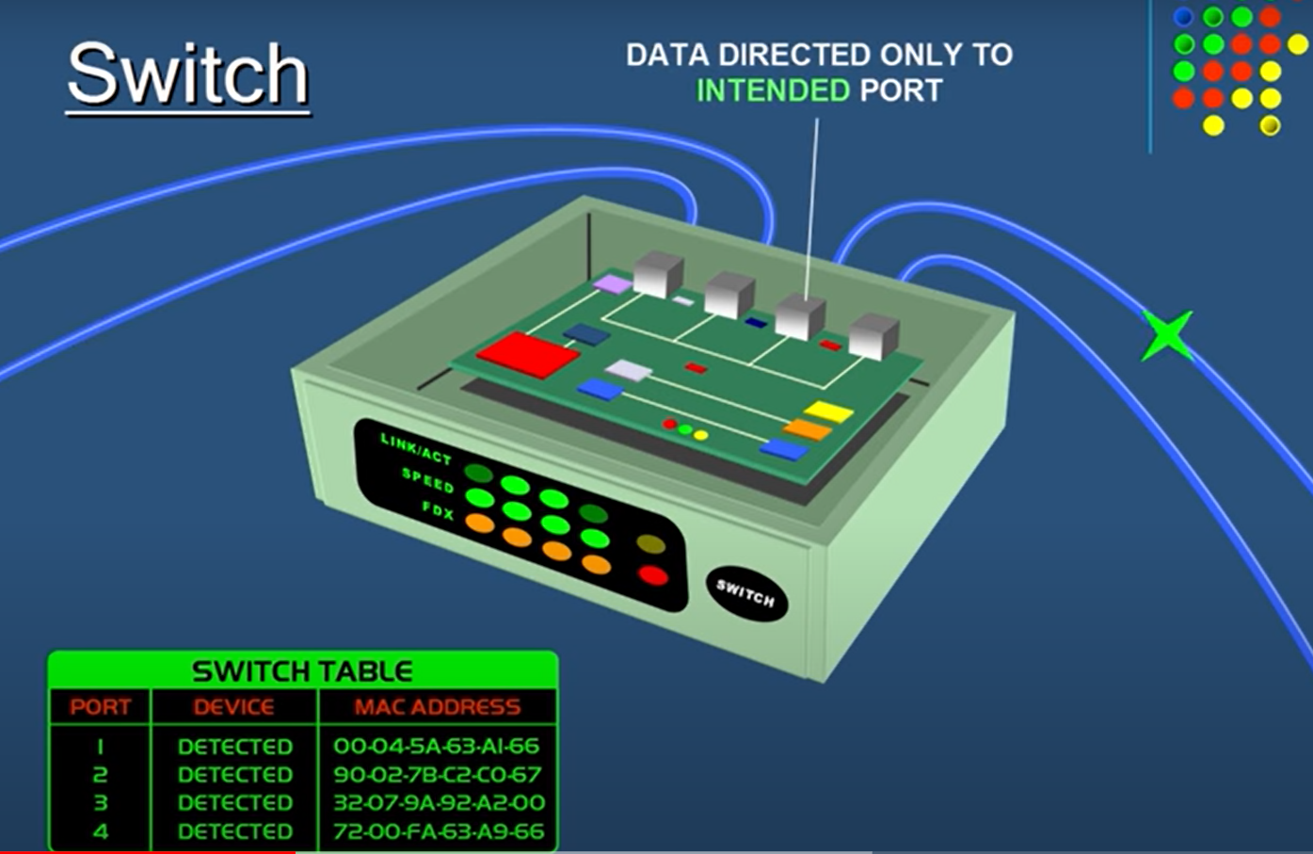
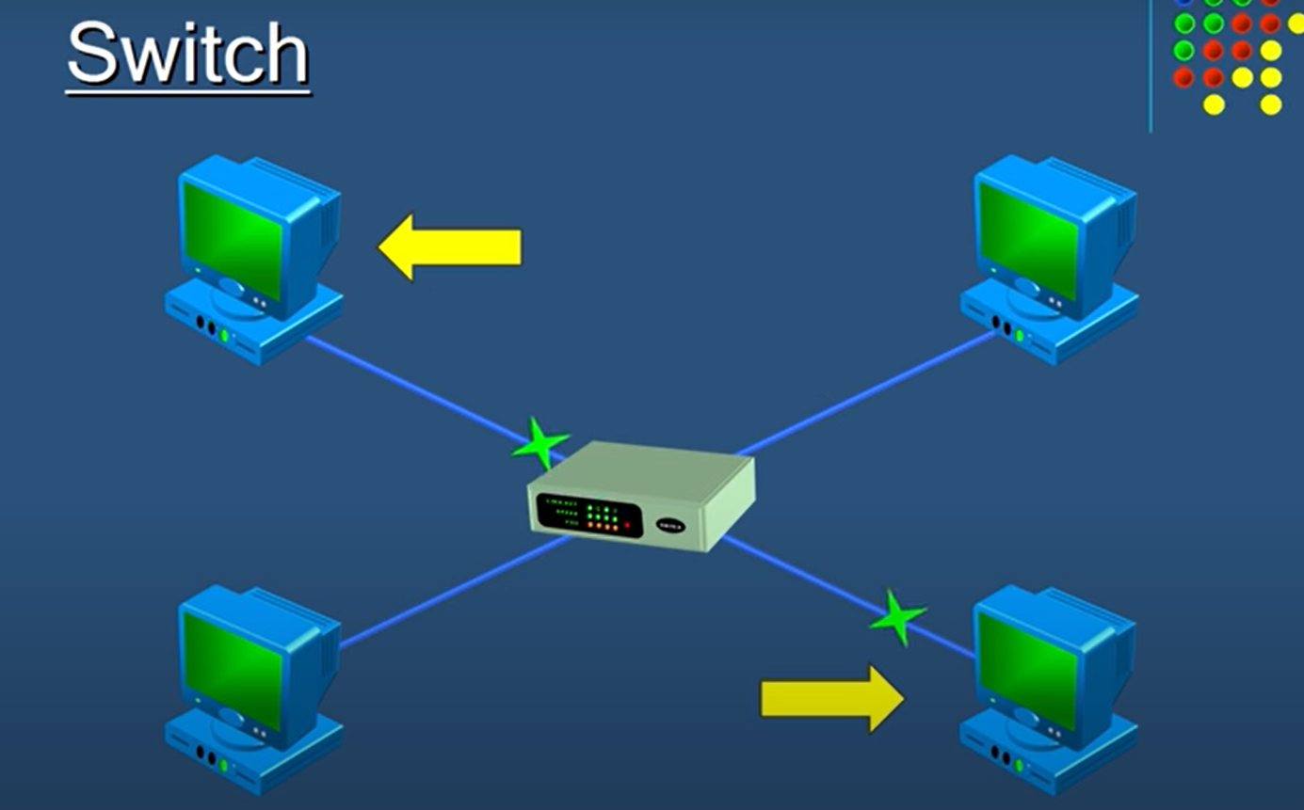
Switch

Slide 14
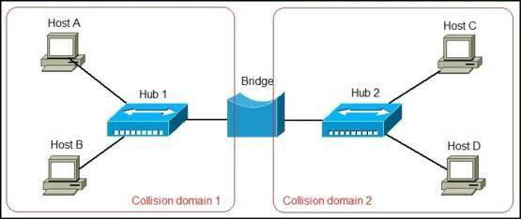
Bridge
A bridge operates at the data link layer.
A bridge is a repeater, with add on the functionality of filtering content by reading the MAC addresses of source and destination.
It is also used for interconnecting two LANs working on the same protocol.

Slide 15
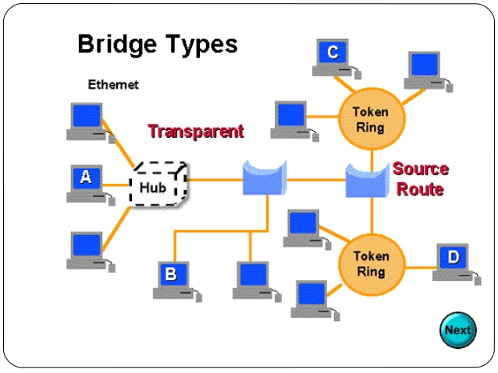
Bridge contd.

Slide 16
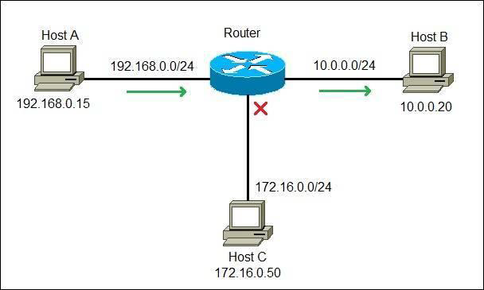
Routers
A router is a device like a switch that routes data packets based on their IP addresses.
Router is mainly a Network Layer device.

Slide 17
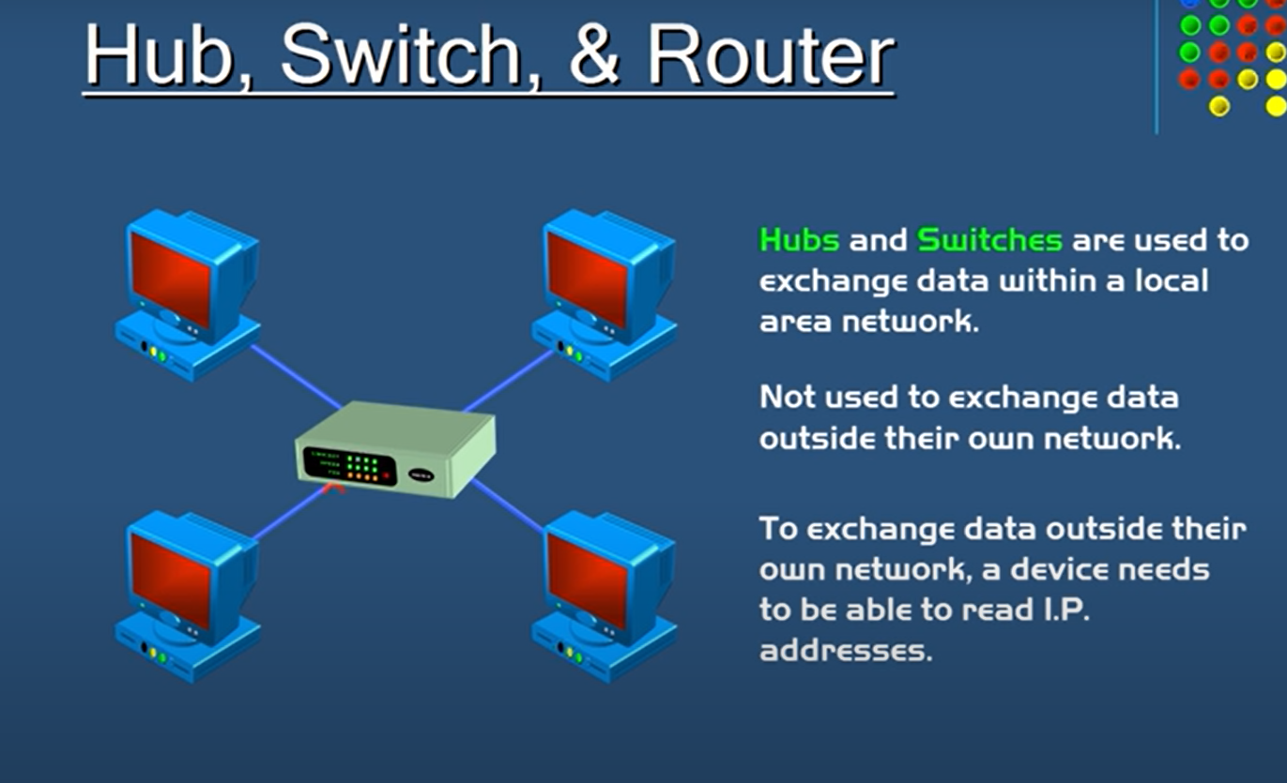
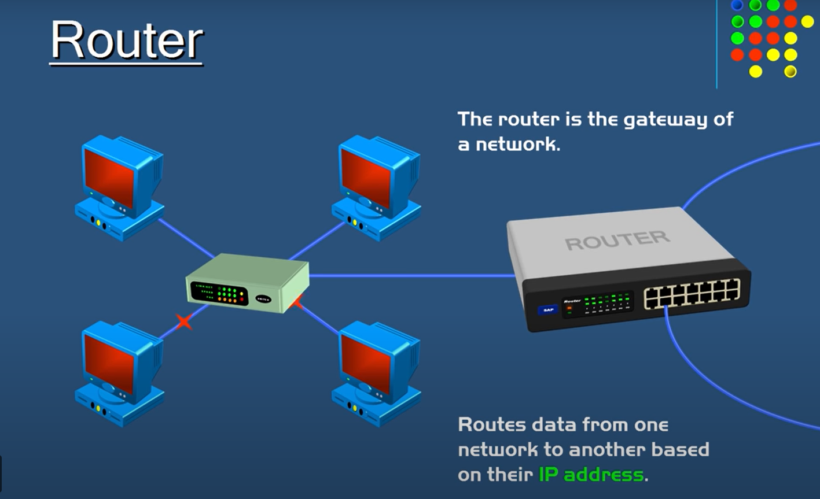
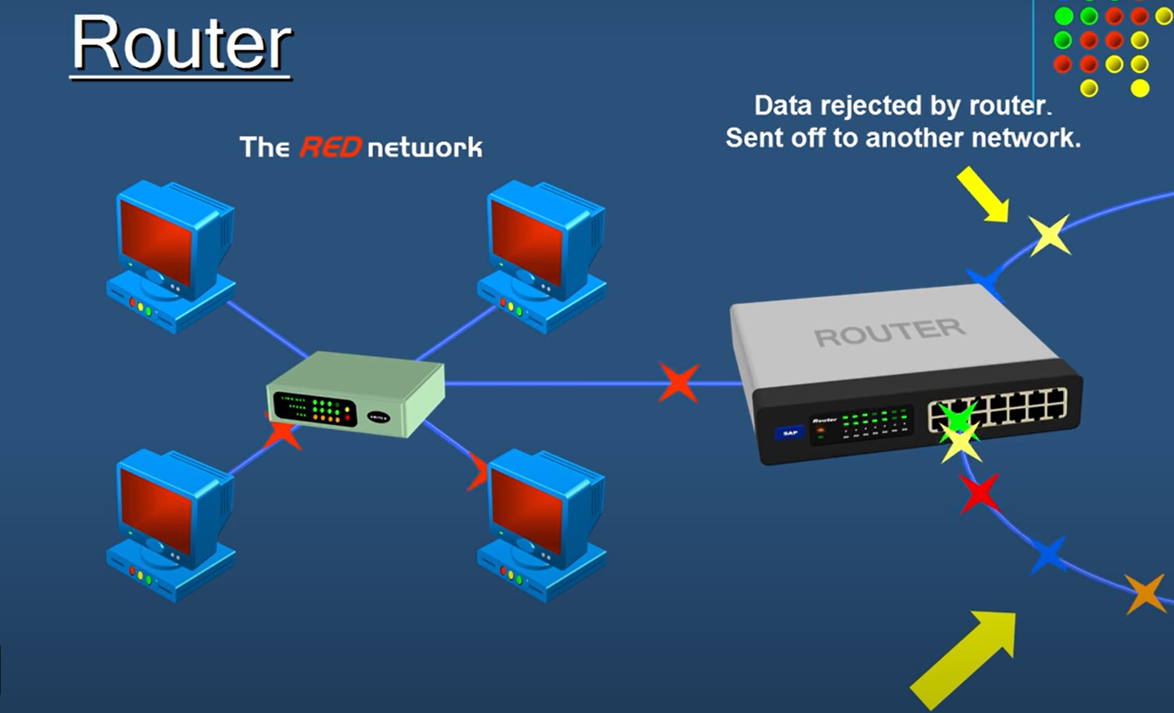
Routers

Slide 18
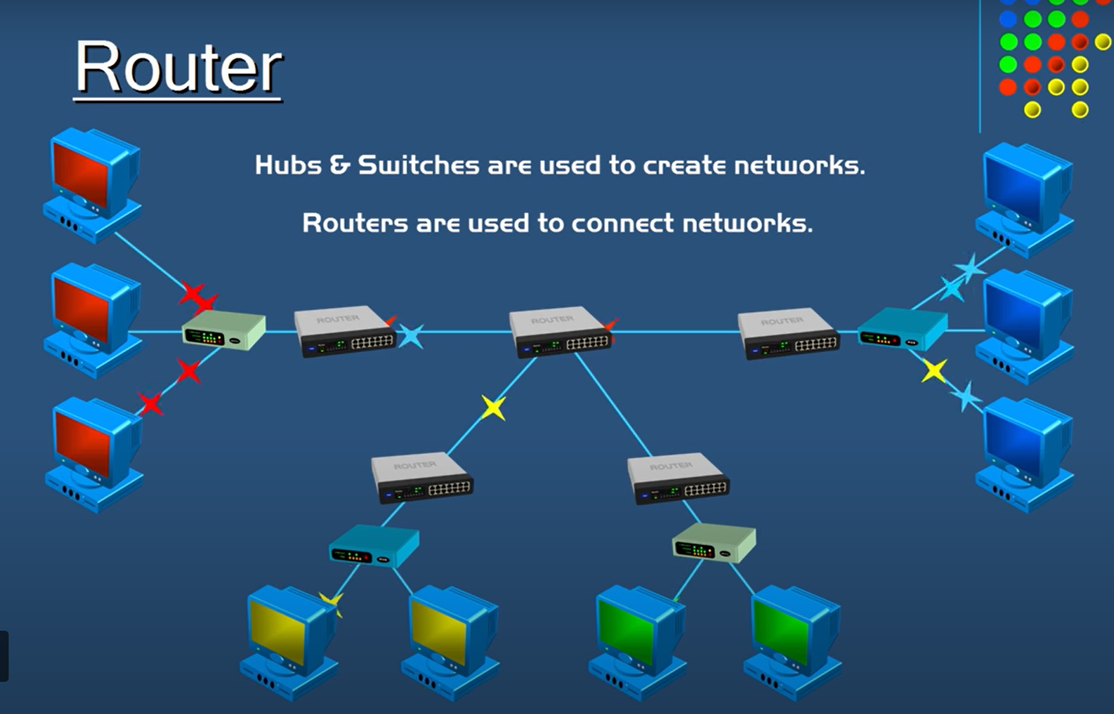
Routers

Slide 19
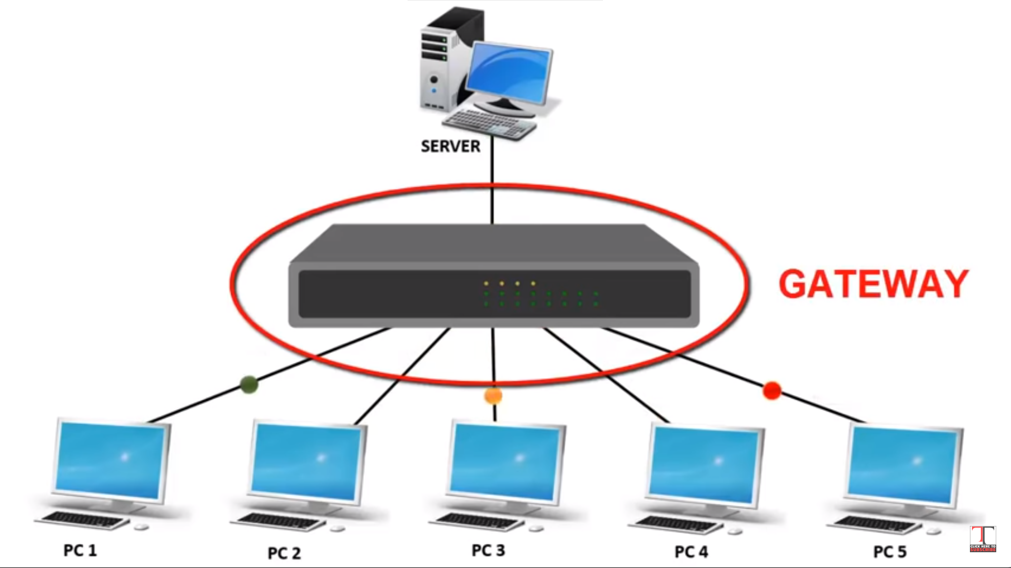
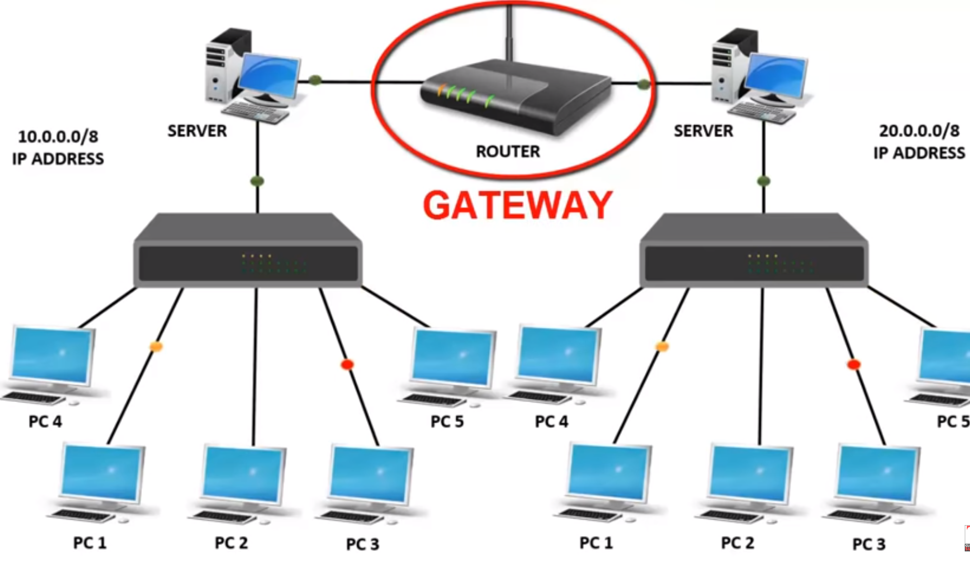
Gateways
gateway, as the name suggests, is a passage to connect two networks together that may work upon different networking models.
They basically work as the messenger agents that take data from one system, interpret it, and transfer it to another system.
Gateways are also called protocol converters and can operate at any network layer. Gateways are generally more complex than switch or router.

Slide 20
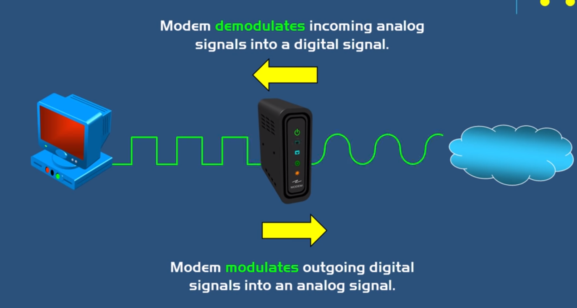
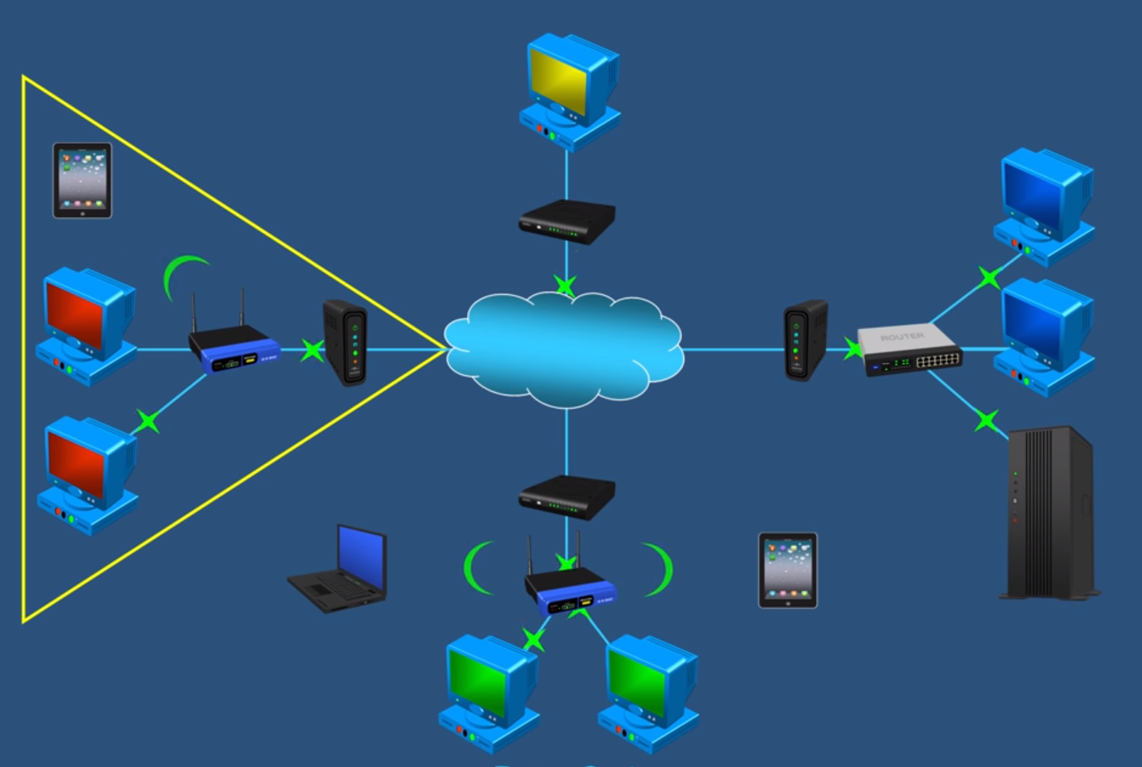
MODEM
A modem, short for modulator/demodulator, is a device that converts the digital signals generated by a computer into analog signals that can travel over conventional phone lines.
The modem at the receiving end converts the signal back into a format the computer can understand.

Slide 21
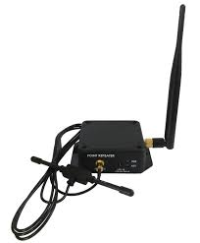
Repeater
A repeater operates at the physical layer.
Its job is to regenerate the signal over the same network before the signal becomes too weak or corrupted so as to extend the length to which the signal can be transmitted over the same network.

